Slide 1


DART
LANGUAGE
IS A CLIENT-OPTIMIZED LANGUAGE FOR FAST APPS ON ANY PLATFORM
DART.DEV

Slide 2
AGENDA
1
DATA TYPES AND VARIABLES
2
OPERATORS
3
DART'S COLLECTIONS
4
FUNCTIONS
5
CLASSES

Slide 3
Data Types
1
2
3
NUM
INTEGER
DOUBLE

Slide 4
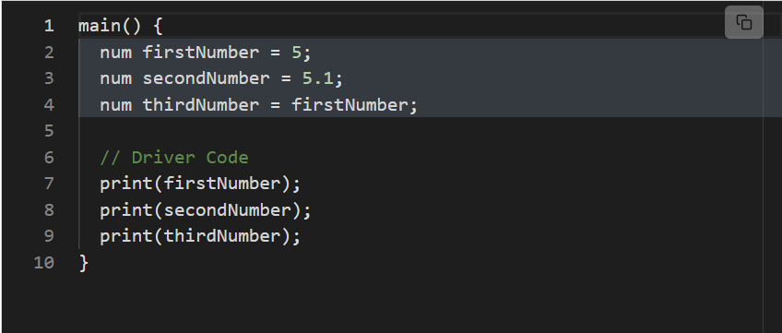

Slide 5
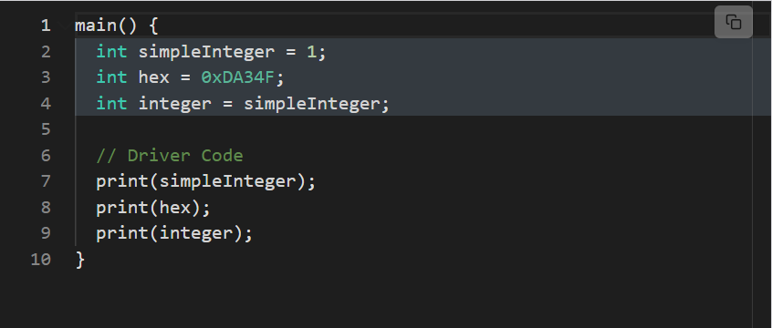

Slide 6
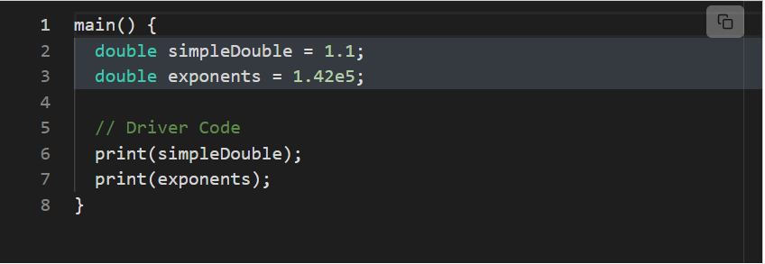

Slide 7
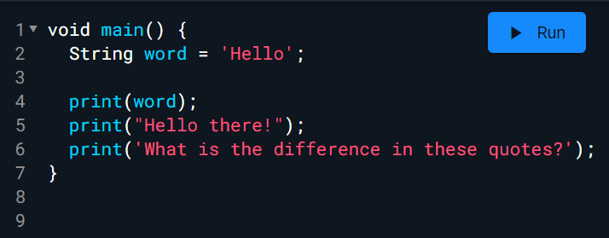
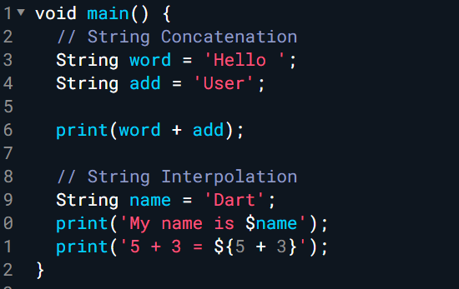
STRINGS
Difference between " and " "

Slide 8
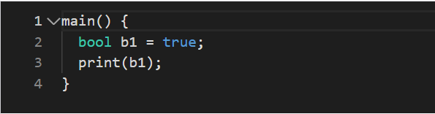
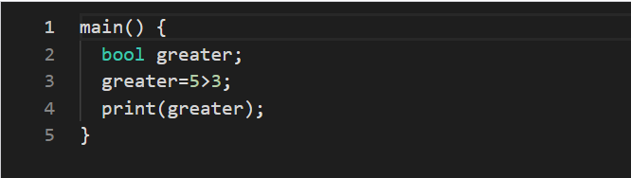
BOOLEAN

Slide 9
WHAT IS TYPE INFERENCE?
TYPE INFERENCE IS A PROGRAMMING LANGUAGE’S ABILITY TO INFER TYPES WHEN NOT SPECIFIED BY THE USER.

Slide 10
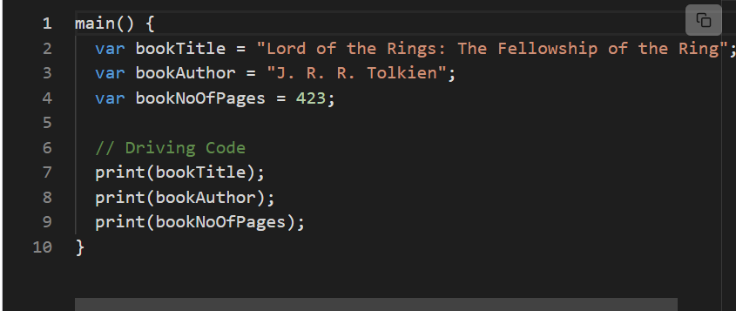
Use runtimeType to define the type of variable:
bookTitle.runtimeType

Slide 11
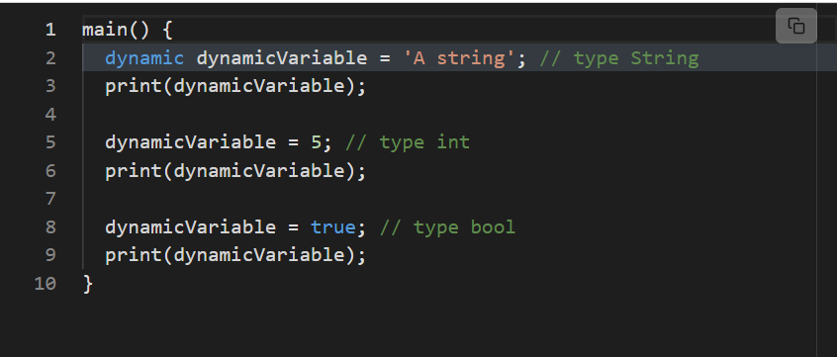

Slide 12
VAR
DYNAMIC
CAN'T CHANGE TYPE, BUT CAN CHANGE A VALUE
CAN CHANGE TYPE AND CAN CHANGE VALUE

Slide 13
FINAL
CONST
CAN'T CHANGE TYPE, BUT CAN'T CHANGE A VALUE
CAN CHANGE TYPE AND CAN CHANGE VALUE

Slide 14
OPERATORS

Slide 15
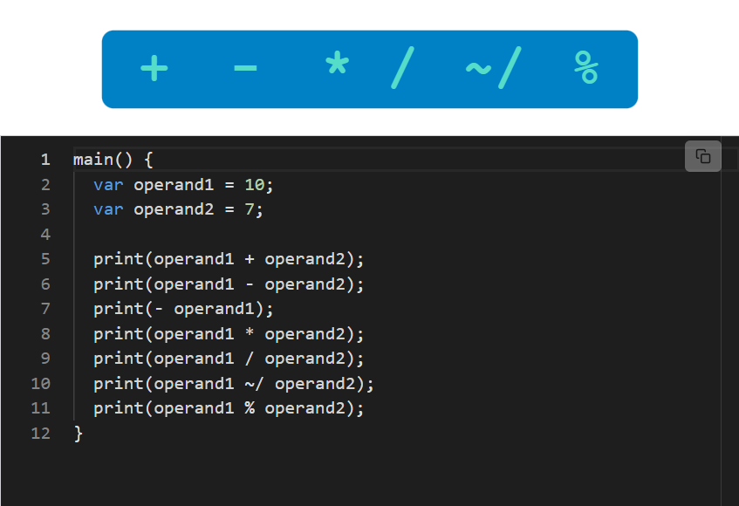
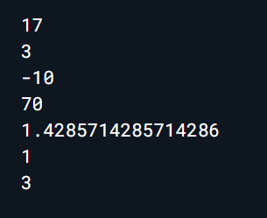

Slide 16
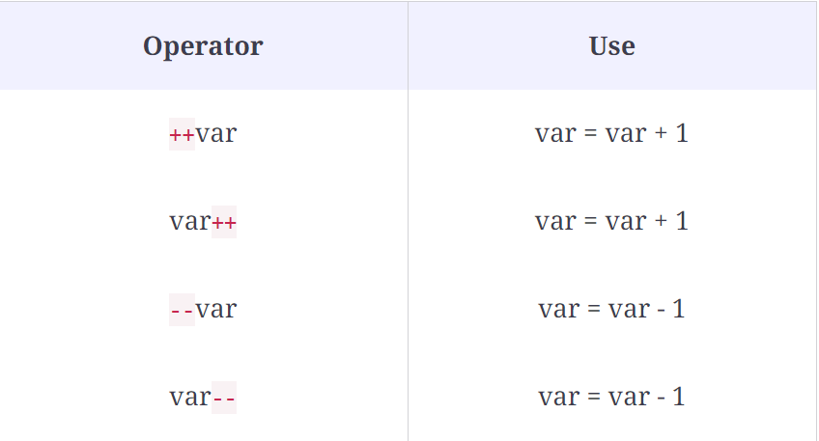
Prefix -> compiles - prints
Postfix -> prints - compiles

Slide 17
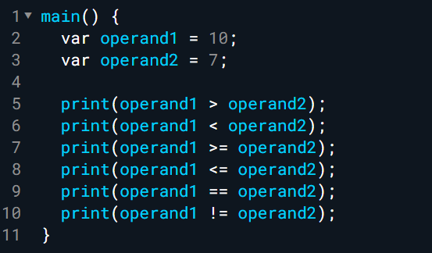

Slide 18
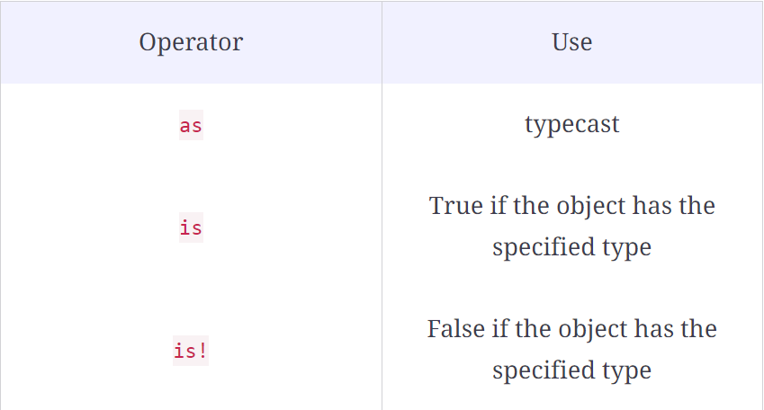
TYPE TEST OPERATORS

Slide 19
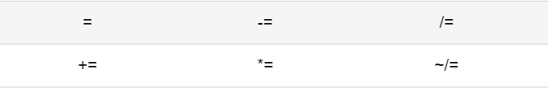
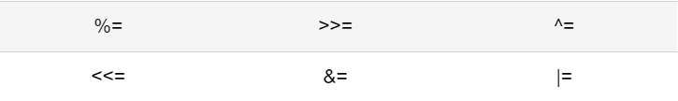
ASSIGNMENT OPERATORS

Slide 20
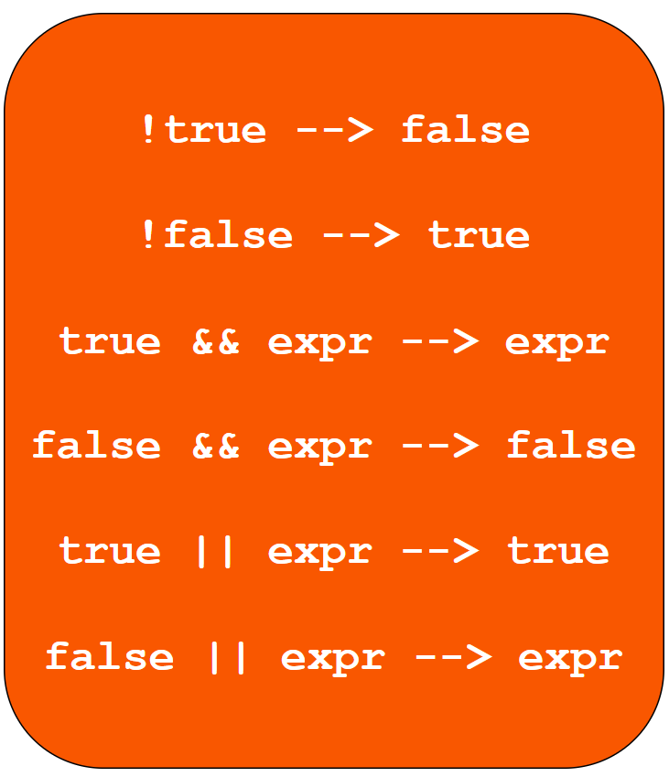

LOGICAL OPERATORS
Bitwise and Shift Operators

Slide 21
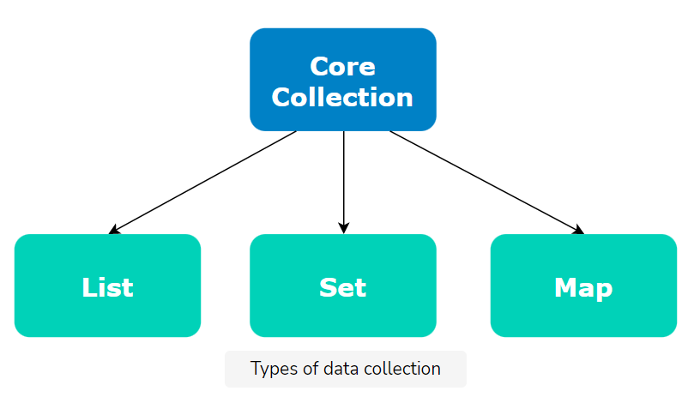
COLLECTIONS

Slide 22
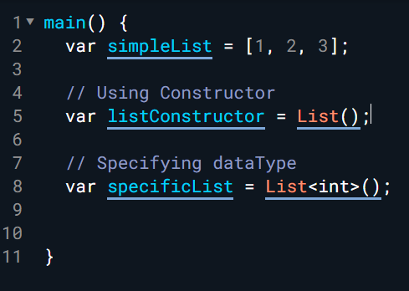
LIST
List by default is heterogeneous, list = [1, 'Hi', false]
To make it homogeneous we use GENERICS, newList = List<int>();

Slide 23
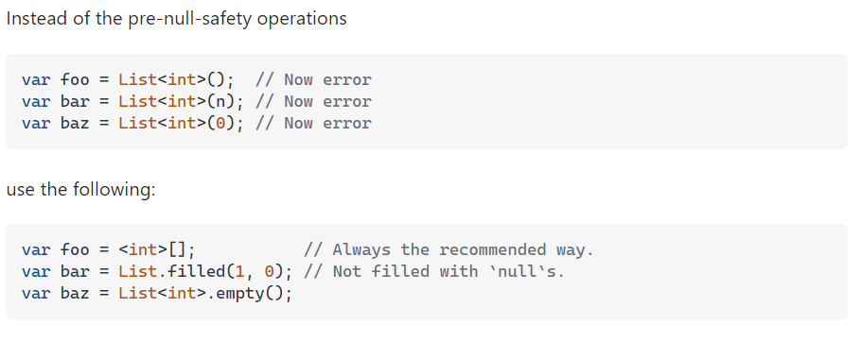

Slide 24
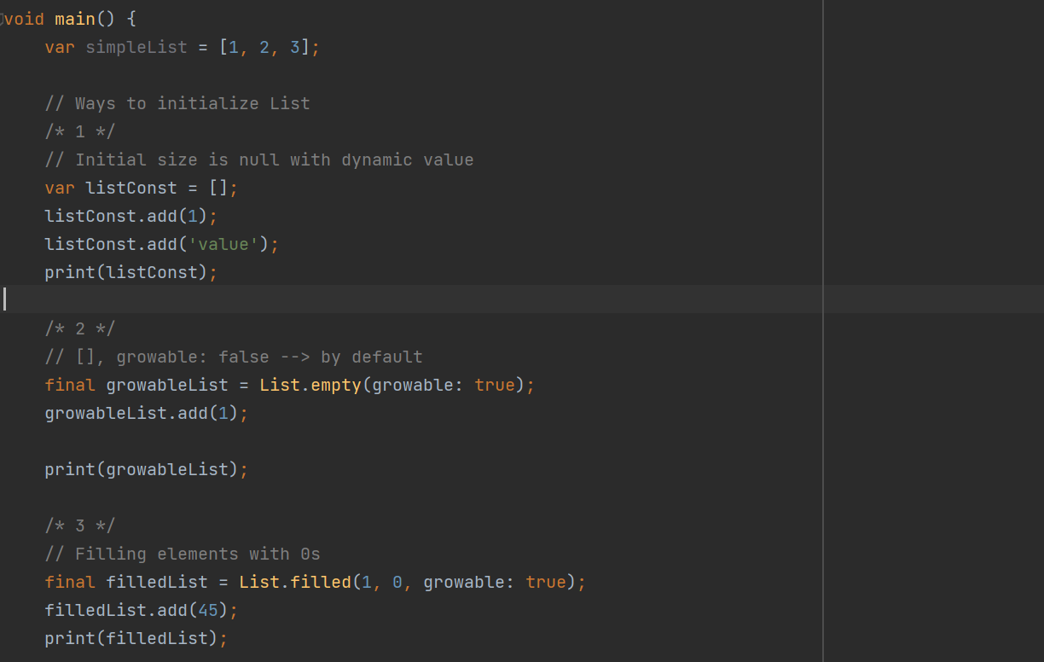

Slide 25
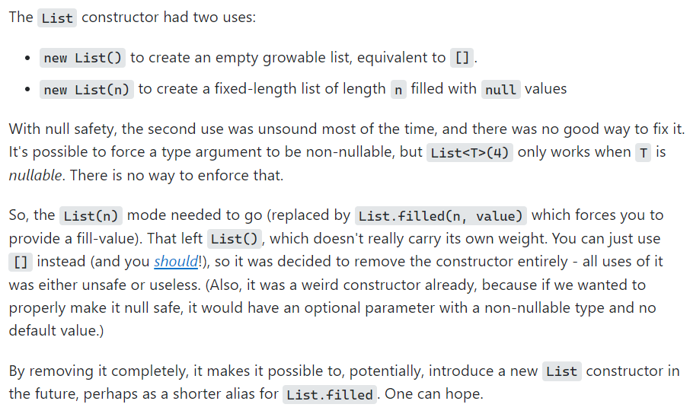

Slide 26
WORKING WITH LIST

Slide 27
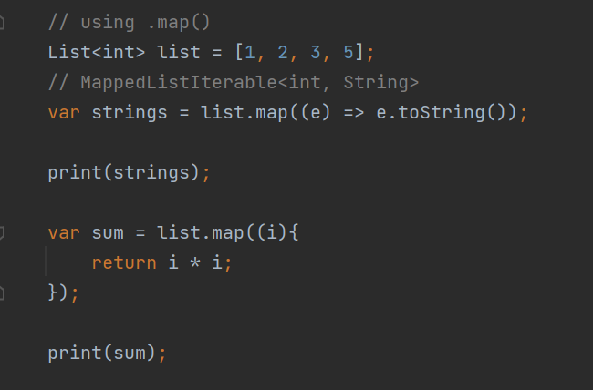
.MAP()

Slide 28
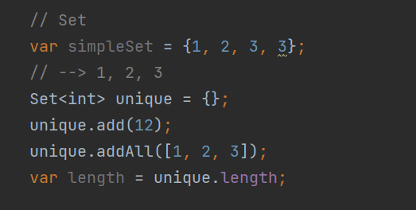
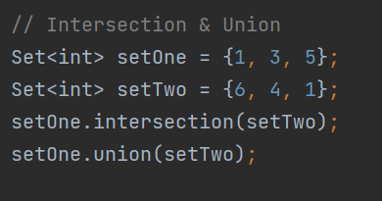
UNORDERED SET

